Slide 1
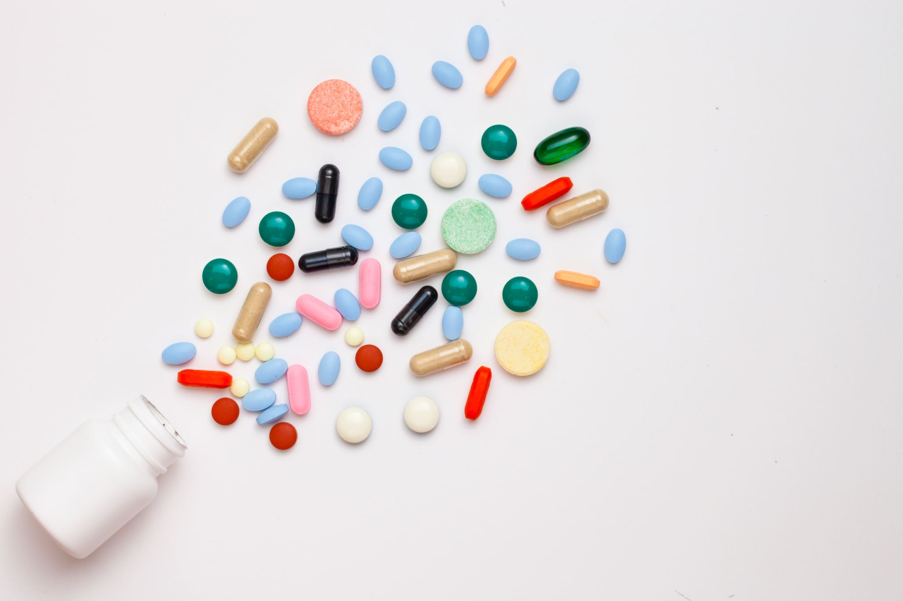
Adverse Drug Reactions (ADRs)
An Adverse Drug Reaction (ADR) is a harmful and unintended response to a medicine.
ADRs can occur when a medicine is used at normal doses for prevention, diagnosis, or treatment.
They may range from mild symptoms to serious, life-threatening conditions.
ADR monitoring is essential for patient safety and effective treatment.

Slide 2
Classification of ADRs
Type A (Augmented): Dose-related and predictable.
Type B (Bizarre): Unpredictable and not clearly dose-related.
Type C (Chronic): Associated with long-term use.
Type D (Delayed): Occur after a period of time.
Type E (End-of-use): Associated with drug withdrawal.
Type F (Failure): Unexpected failure of treatmen

Slide 3
Examples of Common ADRs
1. Insulin — Hypoglycemia
Insulin can lower blood glucose excessively, especially if the dose is too high relative to food intake or activity.
2. Penicillin antibiotics — Allergic reactions
They may cause skin rashes or, rarely, severe anaphylaxis.
3. NSAIDs — Gastrointestinal and kidney effects
Medicines such as ibuprofen may cause gastrointestinal bleeding and kidney injury, particularly in susceptible patients.

Slide 4

Detection and Monitoring of ADRs
1-Patient interviews: Asking about new symptoms after starting a medicine.
2-Clinical assessment: Evaluating symptoms and their relationship to drug exposure.
3-Laboratory tests: Monitoring liver enzymes, kidney function, and blood counts when indicated.
4-Medication review: Checking doses, drug interactions, and the patient's medication history.

Slide 5

Prevention and Management of ADRs
1-Prescribe the correct drug and appropriate dose.
2-Review allergies and medical history.
3-Check for potential drug interactions.
4-Monitor high-risk patients regularly.
5-Educate patients about warning signs and correct medicine use.

Slide 6
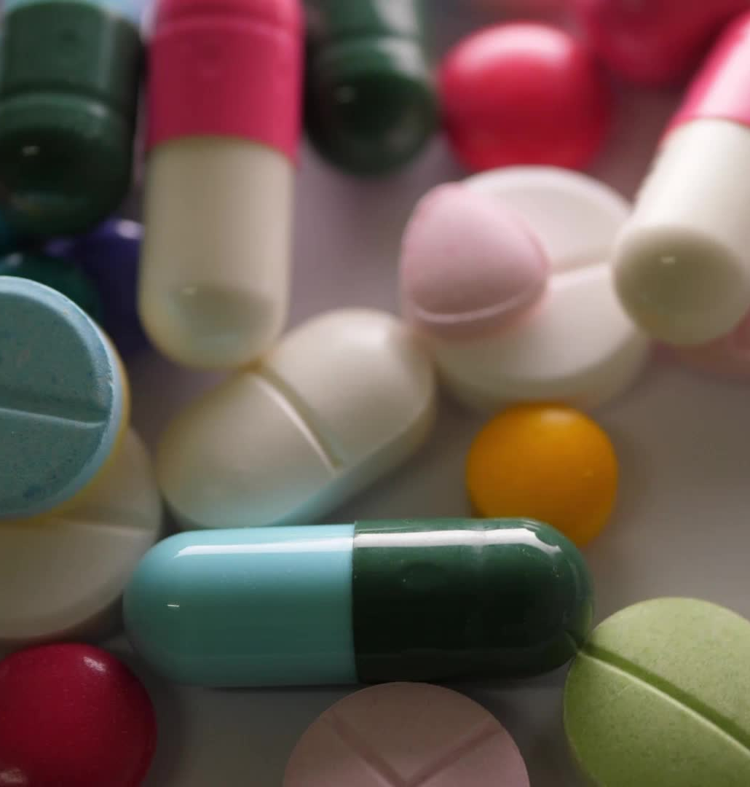
Drug–Drug Interactions
Drug–drug interaction occurs when one medicine affects the action of another medicine.
It may increase or decrease the effect of a drug.
It can cause side effects or reduce treatment effectiveness.
Some interactions are harmless, while others can be dangerous.

Slide 7
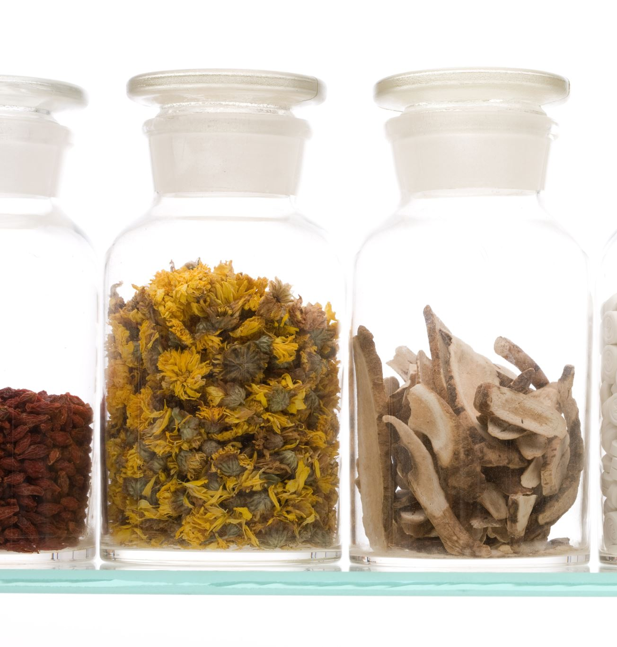
Types of Drug Interactions
There are three main types
1-Drug–Drug Interactions: One medicine affects another medicine
2-Drug–Food Interactions: Food affects the action of a medicine.
3-Drug–Disease Interactions: A medicine worsens an existing disease.

Slide 8
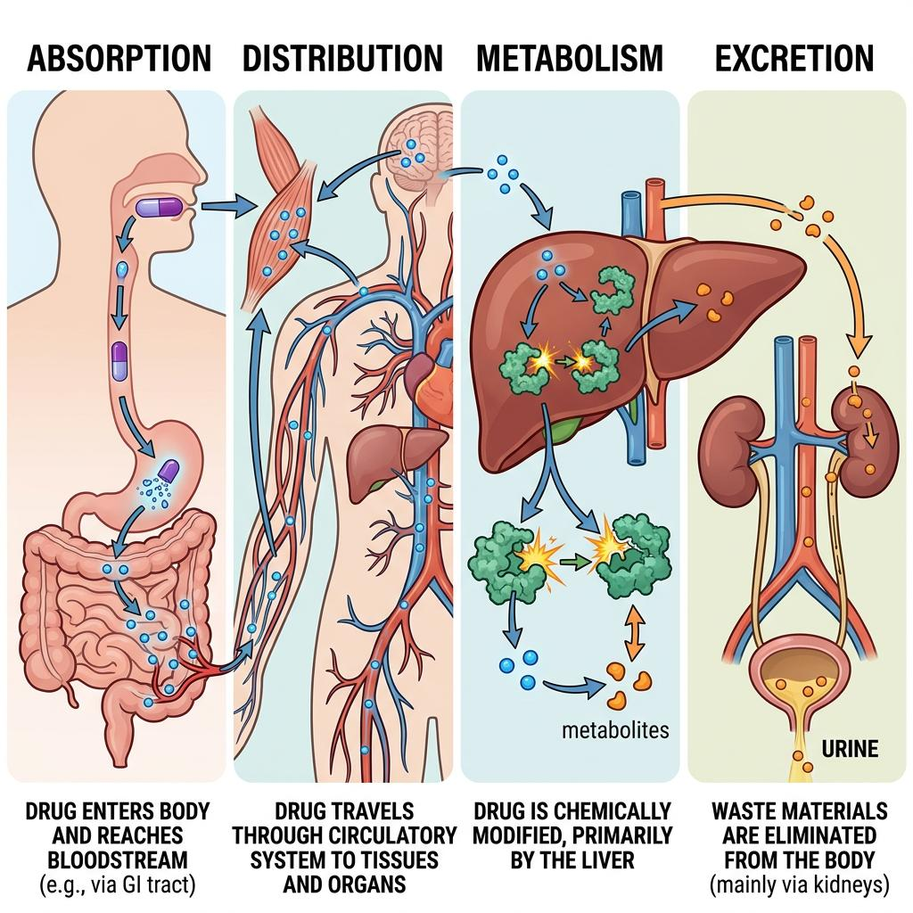
Pharmacokinetic Interactions

Slide 9
Pharmacokinetic interactions occur when one drug changes the amount of another drug in the body
They can affect:
Absorption: How the drug enters the blood.
Distribution: How the drug moves through the body.
Metabolism: How the drug is broken down, mainly in the liver.
Excretion: How the drug leaves the body, often through the kidneys.
Example: Some medicines inhibit drug-metabolizing enzymes and increase the concentration of another drug.

Slide 10
Pharmacodynamic Interactions
Pharmacodynamic interactions occur when two drugs affect the body in similar or opposite ways.
There are two main effects:
Additive or synergistic effect: The drugs increase each other's effects.
Antagonistic effect: One drug reduces the effect of another.
Example: Opioids and benzodiazepines can both suppress the central nervous system.

Slide 11
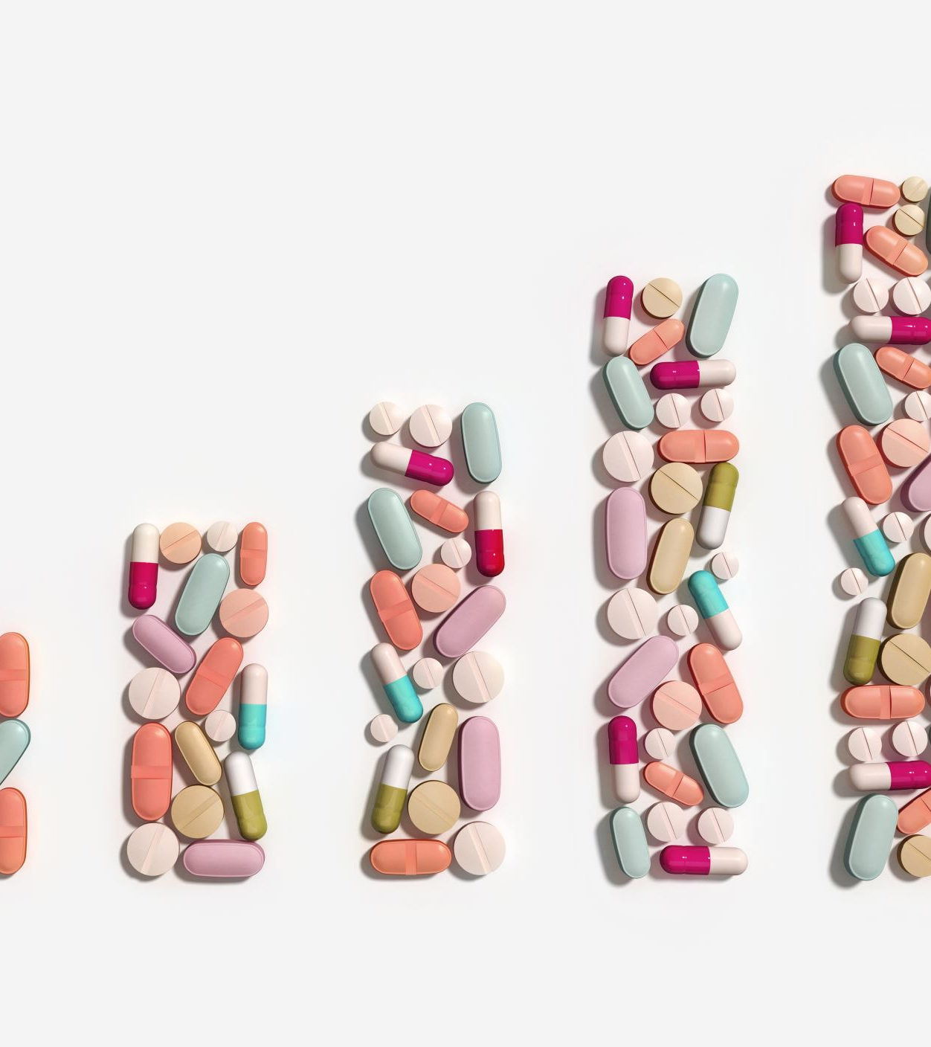
Common Examples
1. Warfarin + Aspirin
May increase the risk of bleeding.
2. Simvastatin + Clarithromycin
Can increase simvastatin levels and the risk of muscle injury.
3. ACE inhibitors + Potassium supplements
May increase potassium levels in the blood

Slide 12
Signs and Symptoms
Drug interactions may cause
Dizziness or excessive sleepiness.
Nausea and vomiting.
Unusual bleeding or bruising.
Muscle pain or weakness.
Abnormal heart rhythm.
Reduced therapeutic effect

